Slide 1


Telecom Churn Analysis

Slide 2
Telecom Churn Analysis
Group No. 5
Team Members:
Rahul Patil
Rajath J K
Maheshreddy P
Ganesh M
Devan Thampi SP
Under Esteemed Guidance of
Mr. Jayveer Nanda

Slide 3

Brief Overview
Churn Prediction is one of the most popular Big Data use cases in Business. It consists of detecting customers who are likely to cancel a subscription a service.
Churn is a problem for telecom industries because it is more expensive to acquire a new customer than to keep your existing from leaving.
NOTE :- Telecom Industry today measure voluntary churn by a monthly figure, such as 1.9 or 2.1 percent.

Slide 4
Project Objective
To predict customer churn.
Highlighting the main variables/factors influencing the customer churn.
Use of various ML Classification algorithms to build prediction models, evaluate the accuracy and performance of these models.
Finding out the best model for the given dataset.

Slide 5
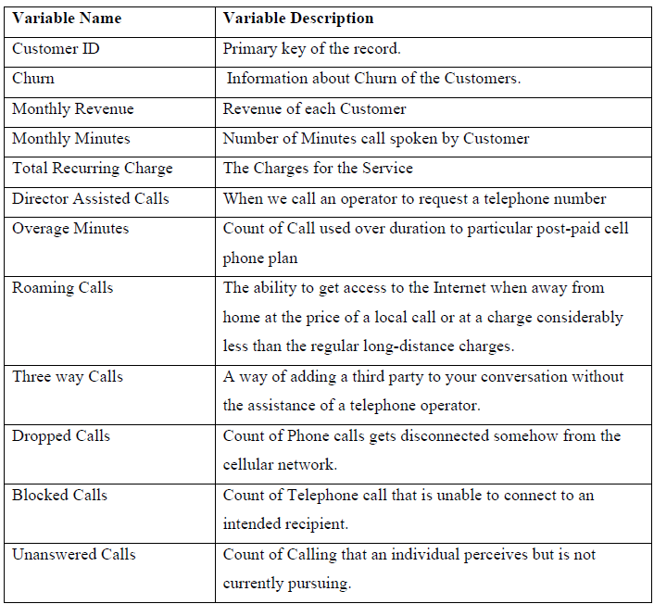
Dataset Information
Data is taken from Kaggle (Telecom churn Dataset)
No. of features: 58
No. of records: 51047
Target Column: Churn
Redundant columns: Customer Id, Service area.
No. categorical columns : 21

Slide 6
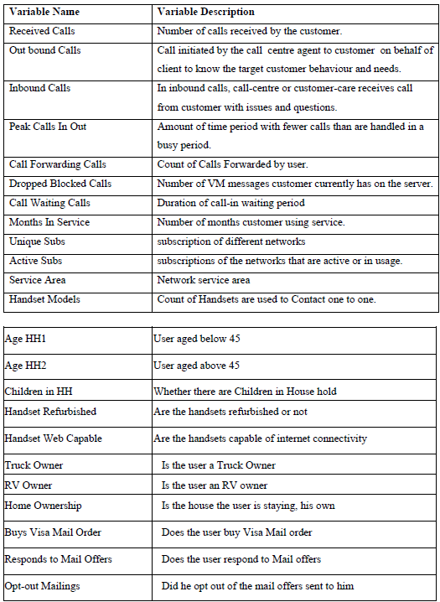
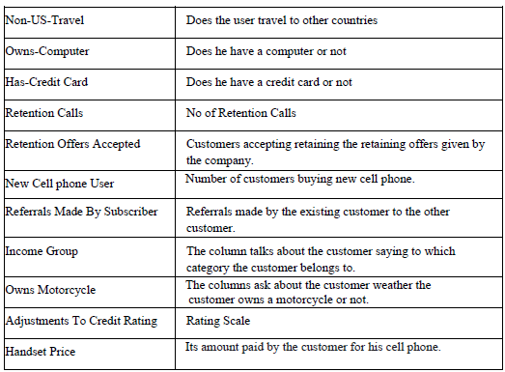

Slide 7
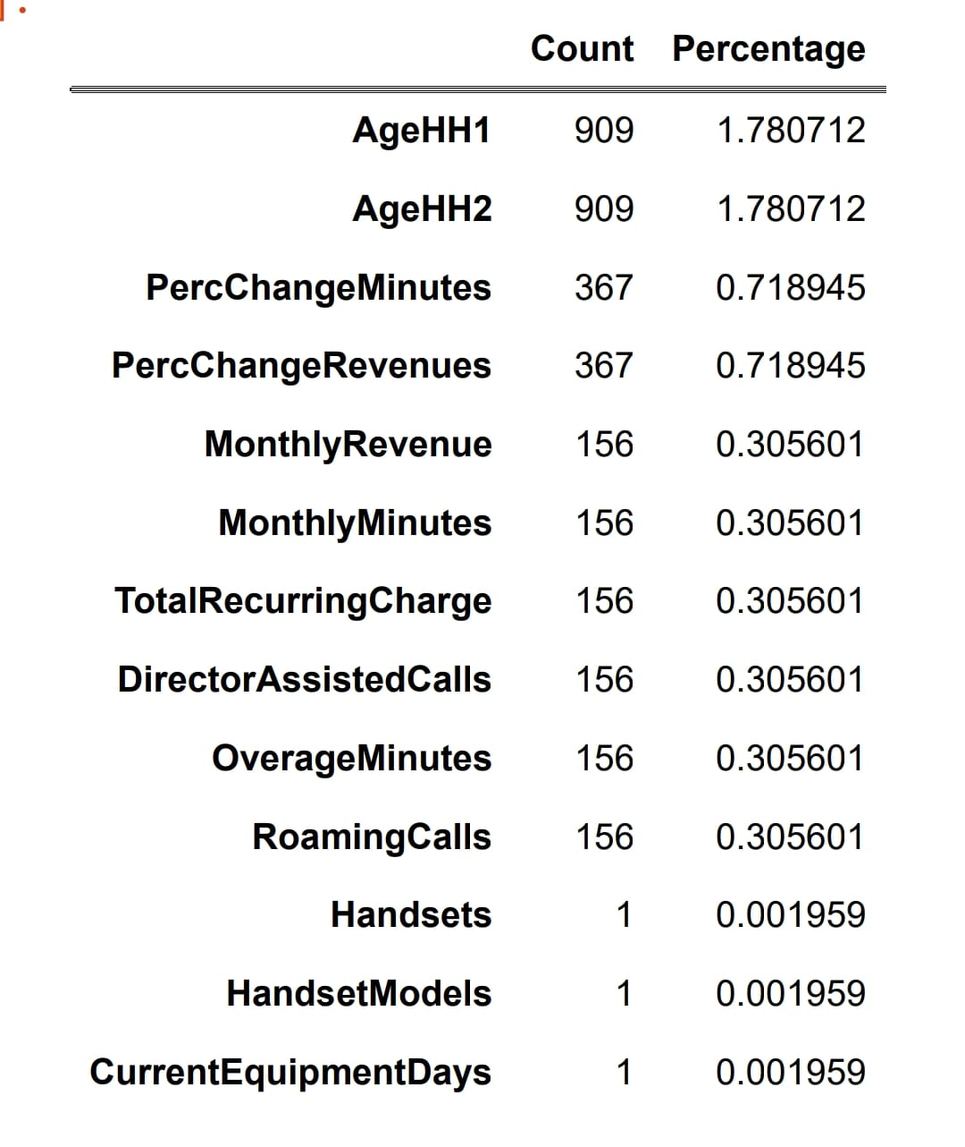
Exploratory Data Analysis (EDA)
Missing Values
Out of 56 features 13 had missing values.
11 of them had less than 1% of missing values, hence Categorical we imputed with mode, for numerical we imputed with mean.
AgeHH1 and AGEHH2 were treated using median value imputation.

Slide 8
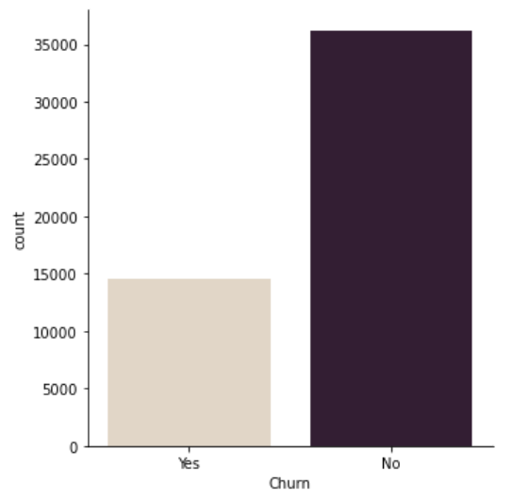
Univariate Analysis
In our data over 28% people have churned ,that is around 14,500 of them.

Slide 9
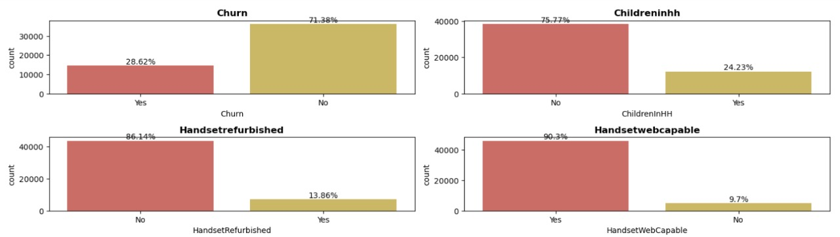
Exploratory Data Analysis (EDA)
Univariate Analysis:
Churn Over 28 percent of people in the data have churned.
2) Handsetwebcapable More than 90 percent of the people in the data have internet support on their phone.

Slide 10
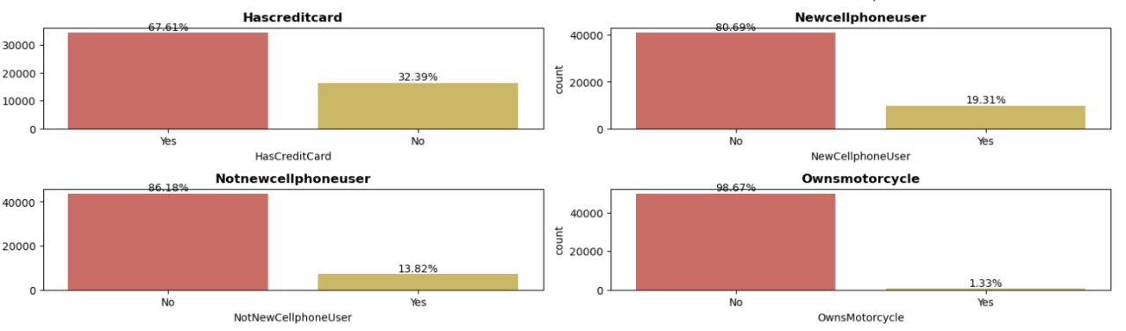
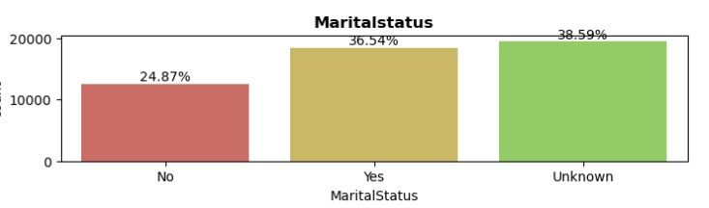
3) More than 65 percent of them don't have a credit card
4) Less than 2 percent of them own a motorcycle
5) More than half of the people's handset price is unknown
6) Over 70 percent of the data has occupations other than the ones mentioned.
7) Martial status of 60 percent of the data is known out of which, 25 percent are not married. The rest are unknown.

Slide 11
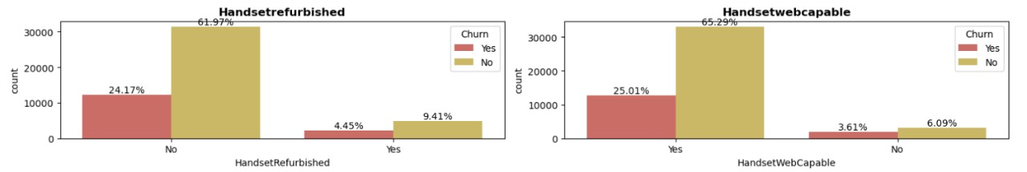
Bivariate and Multivariate Analysis
In Handset web capability over 25% of people who have churned has more than 90% of Internet capability on their phone.
Less than 6% of people who own New phone have churned

Slide 12
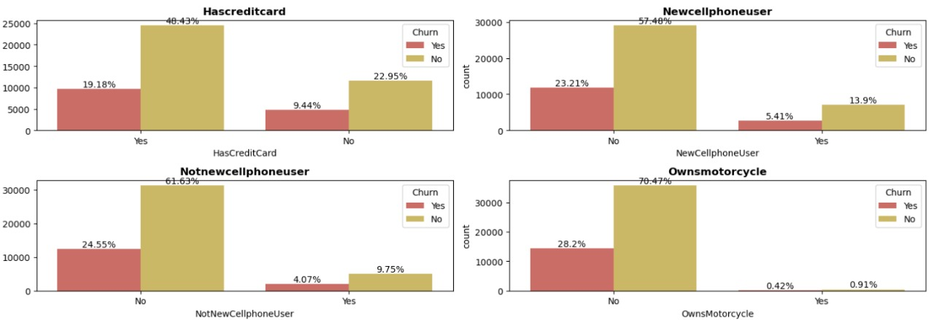
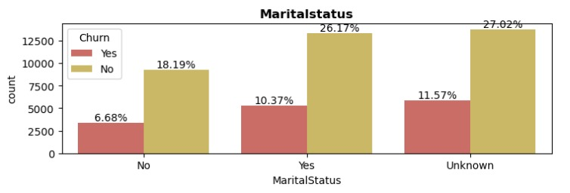
Data show that people who have Credit Cards are more likely to Churn
Marital Status of people churning is independent
People who have responded mail offer are less likely to churn

Slide 13
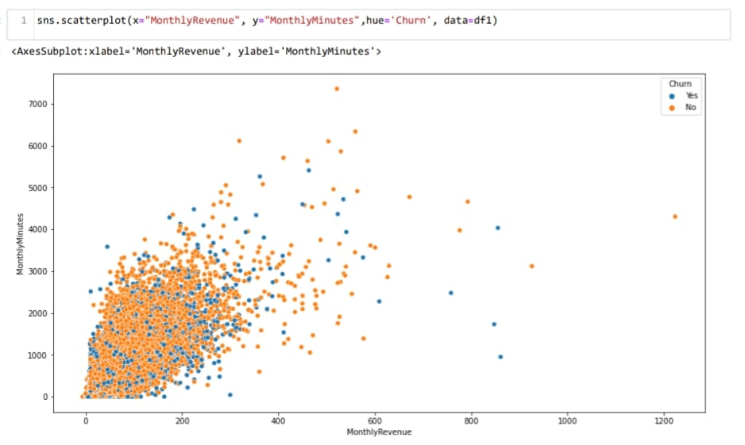
Bivariate and Multivariate Analysis
Observation:
According to plot as Monthly Revenue Increases, Then the number of Monthly Minutes increases, But we can't draw any conclusion on churn

Slide 14
Statistics
Chi-Square Test for Independence :
This test is used to test whether the categorical variables are independent or not.
𝐻0: The variables are independent
𝐻1: The variables are not independent (i.e. variables are dependent)
Here we can check if the categorical features are dependent on our target . We are assuming the level of confidence as 95%
The dependent categorical variable found after Chi-Square Test for Independence are:
ChildrenInHH
HandsetRefurbished
HandsetWebCapable
Homeownership
BuysViaMailOrder
RespondsToMailOffers
MadeCallToRetentionTeam
CreditRating
PrizmCode
MaritalStatus

Slide 15
Statistics
Kruskal Wallis test to check its dependence on the target variable
The null and alternative hypothesis for Kruskal Wallis test is given as:
𝐻0: The data samples are with equal median (independent).
𝐻1: The data samples do not have equal median(i.e. variables are dependent).
Assuming the level of confidence as 95%
The independent numerical variable found after H-test Test:
RoamingCalls
PercChangeRevenues
CallForwarding
CallsHandsetPrice

Slide 16
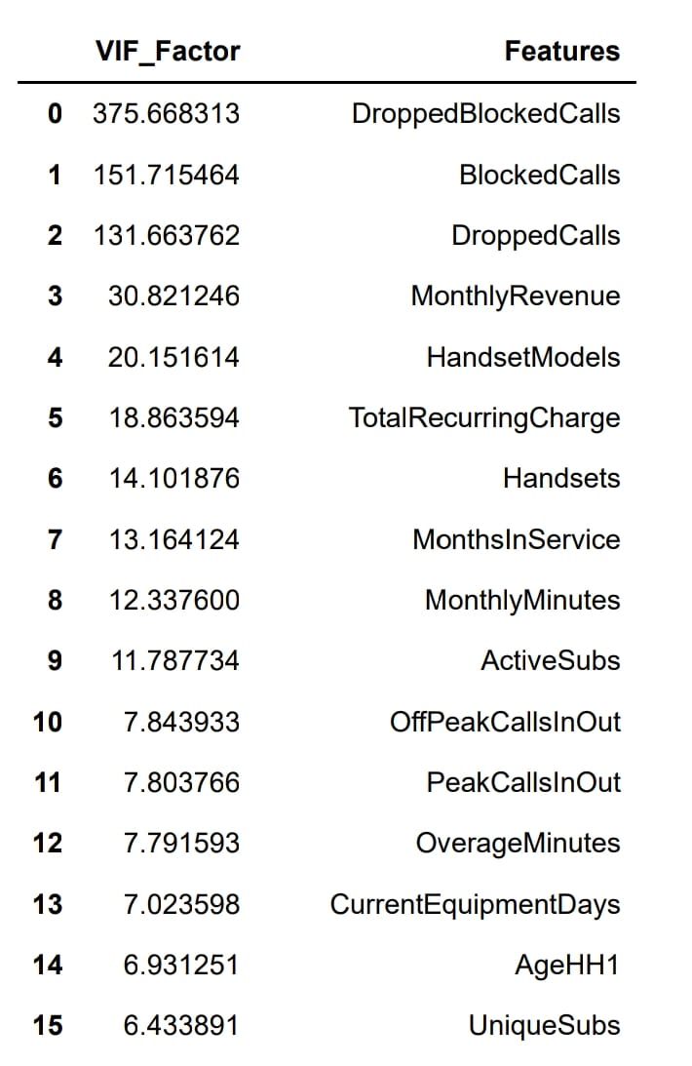
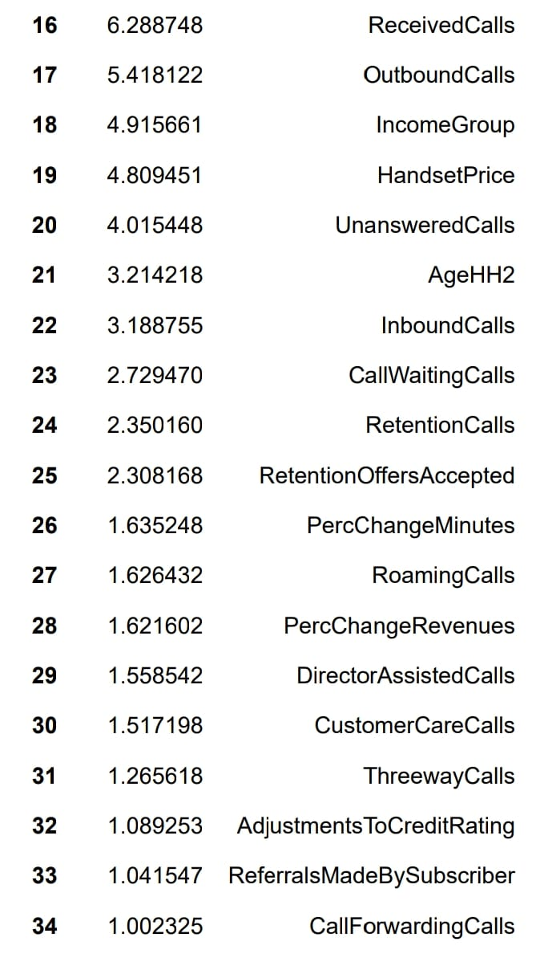
Multi- collinearity Check
Note:- VIF of 0-9 Columns are high (VIF>10)

Slide 17
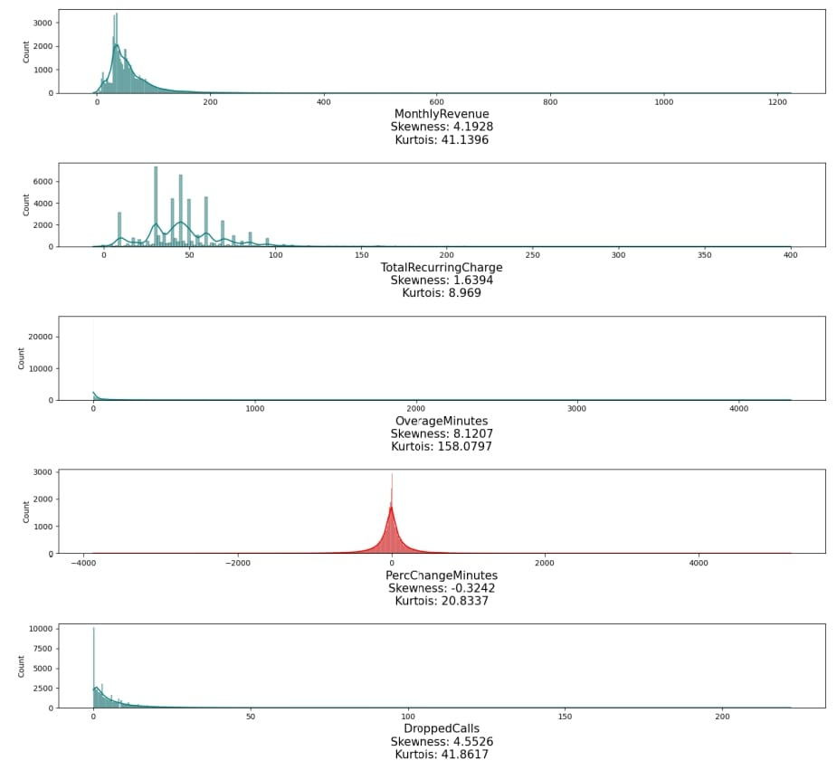
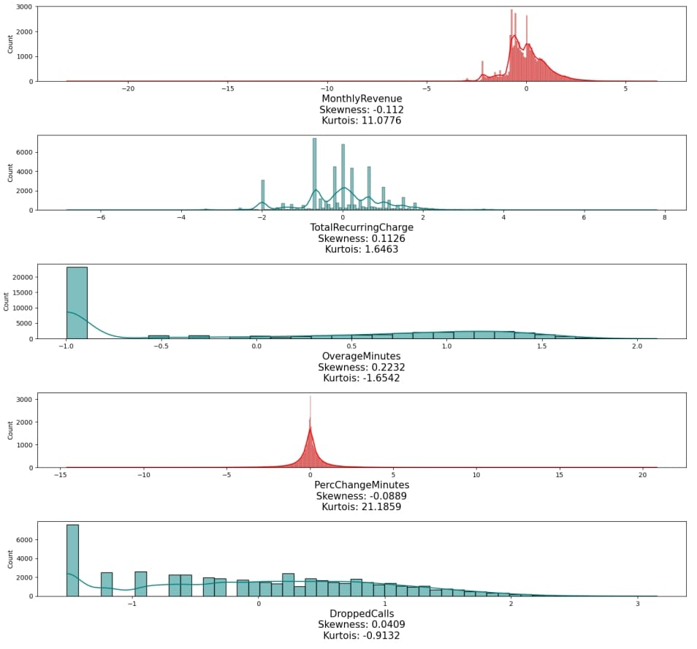
Skewness Before and After Power Transformation

Slide 18
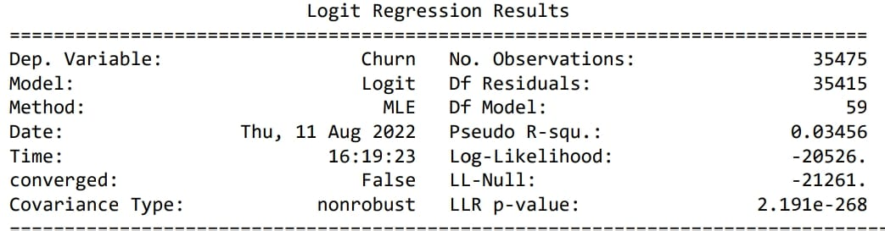
Logistic Regression (Base Model)
Interpretation:
The Pseudo R-squ. obtained from the above model summary is the value of McFadden's R-squared.
The LLR p-value is less than 0.05, implies that the model is significant.
The AIC (Akaike Information Criterion) value is 41172.911.
Kappa score is 0.03 is slight agreement.

Slide 19
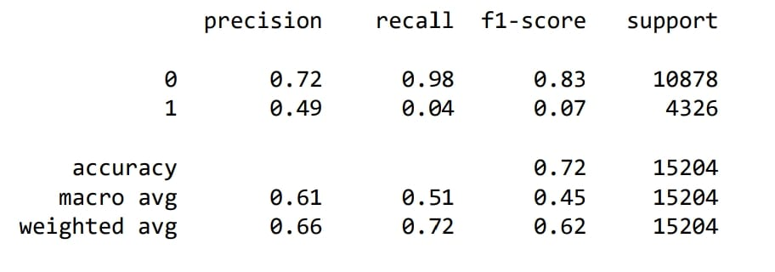
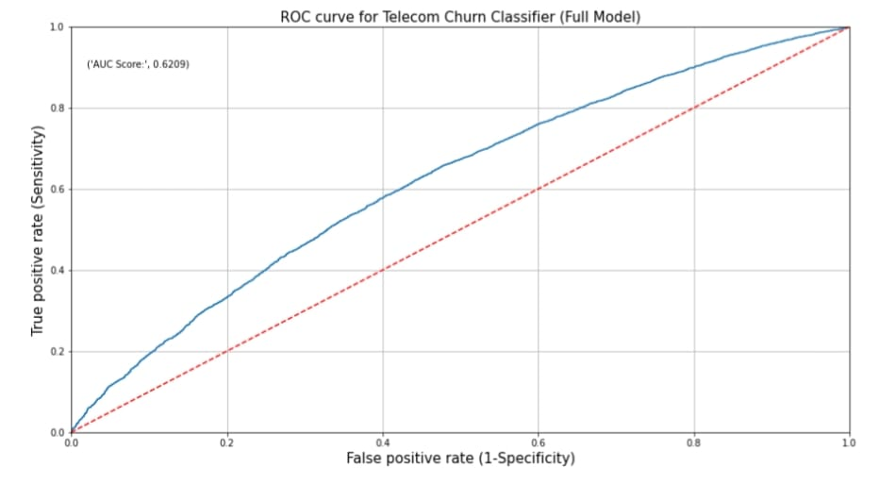
Classification Report:
we can infer that the recall of the positive class is known as sensitivity and the recall of the negative class is specificity.
Accuracy of model is 0.72
ROC Curve:
The red dotted line represents the ROC curve of a pure random classifier; a good classifier stays as far away from that line as possible (towards top-left corner).
From the above plot, we can see that our classifier (logistic regression) is away from the dotted line; with the AUC score 0.6209.

Slide 20
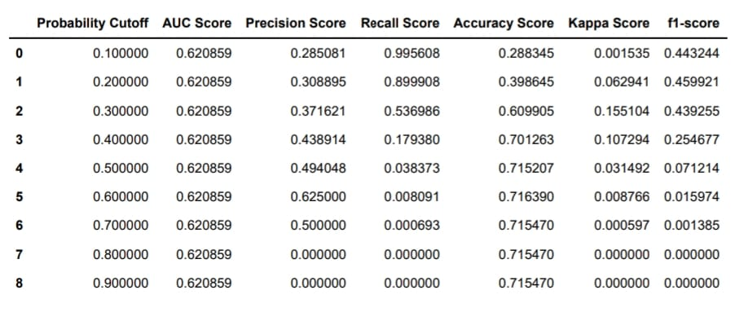
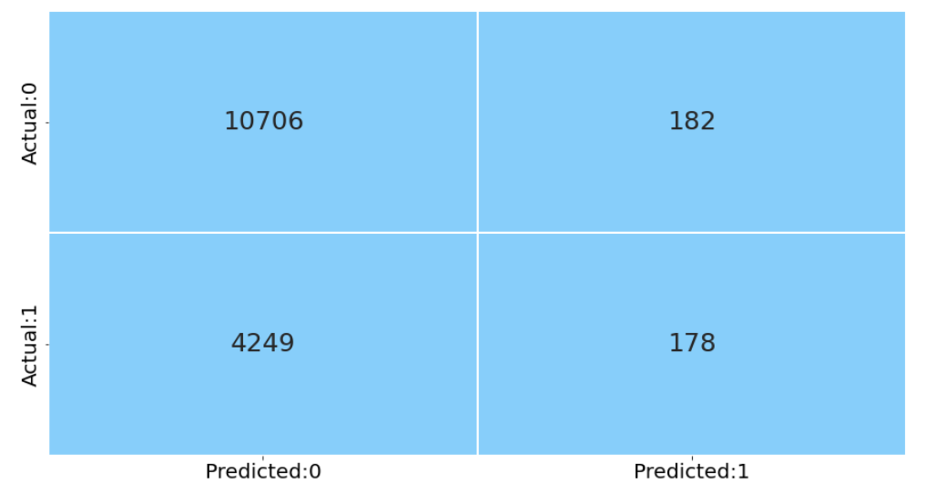
Conclusions:
Base model performance is not so good, but it can be improved by passing different values and obtain a cut-off based on the passed values (Youden's Index, Cost-based Method).
Hyperparameter tuning can lead to more optimized model.

Slide 21
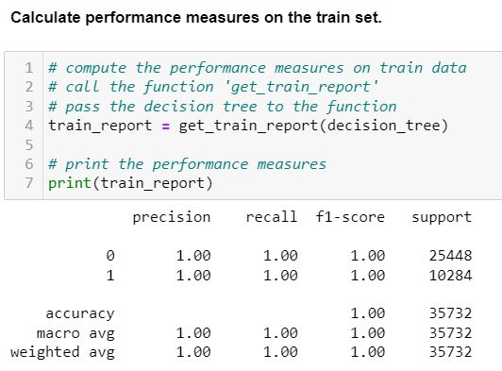
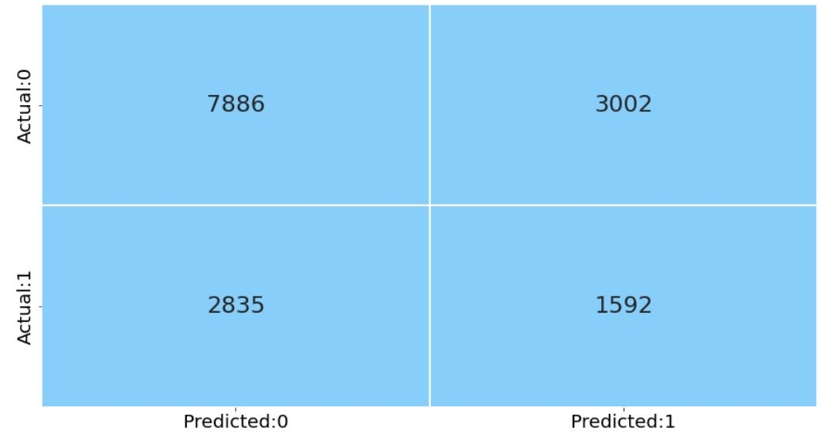
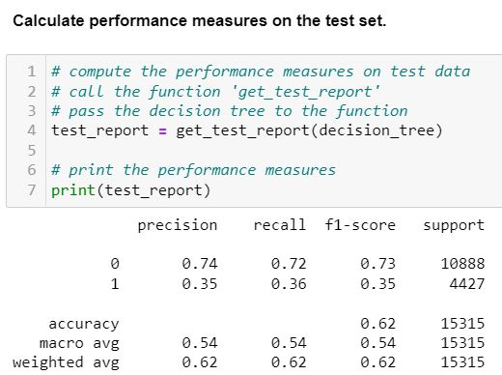
Decision Tree
Confusion-Matrix :-
Interpretation of this Model :-
The Model is Overfitted.
As a result of this the FN and FP values are
wrongly predicted.
We Hyper tune the parameters and rebuild the model.

Slide 22
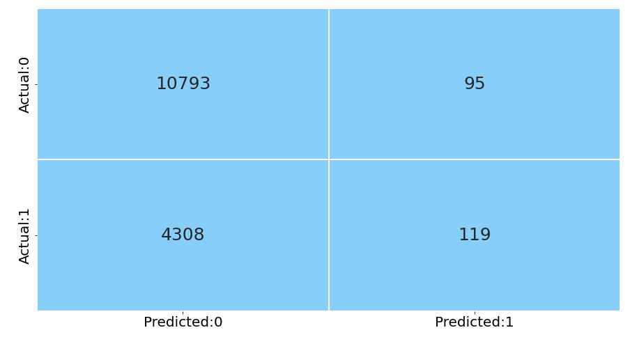
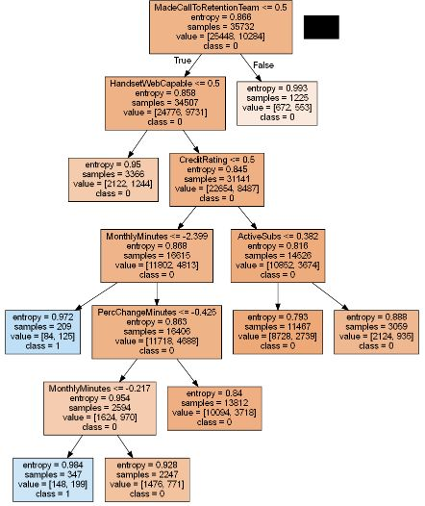
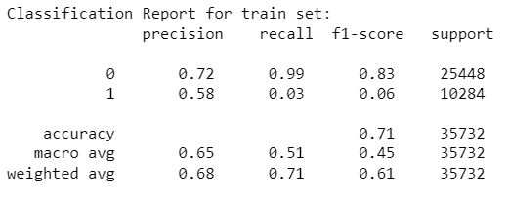
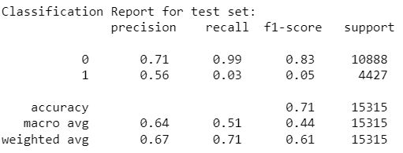
Hyper tuned -Decision Tree

Slide 23
Interpretation of Hyper tuned Decision Tree :-
The train and test accuracies are comparable , hence the overfitting is reduced.
We observe that the FN values are too HIGH .
Typically Random Forest classifier is more accurate than a single decision tree, we rebuild the model using the same to reduce the FN and increase the accuracy .

Slide 24
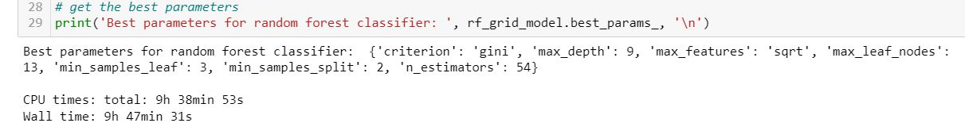
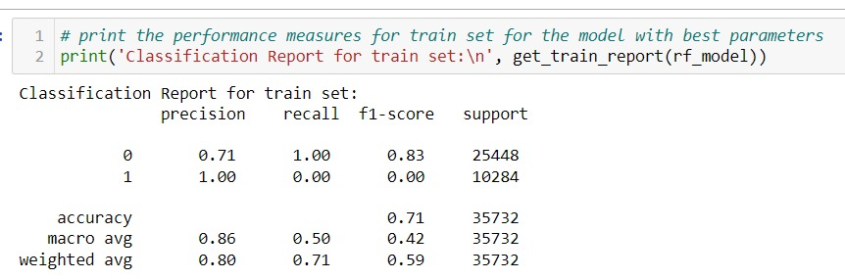
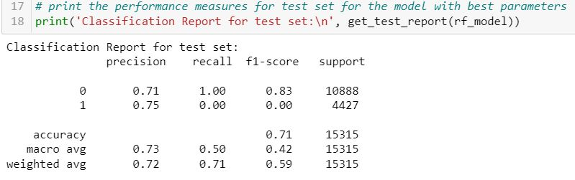
Best parameters and classification report of tuned Random Forest model:

Slide 25
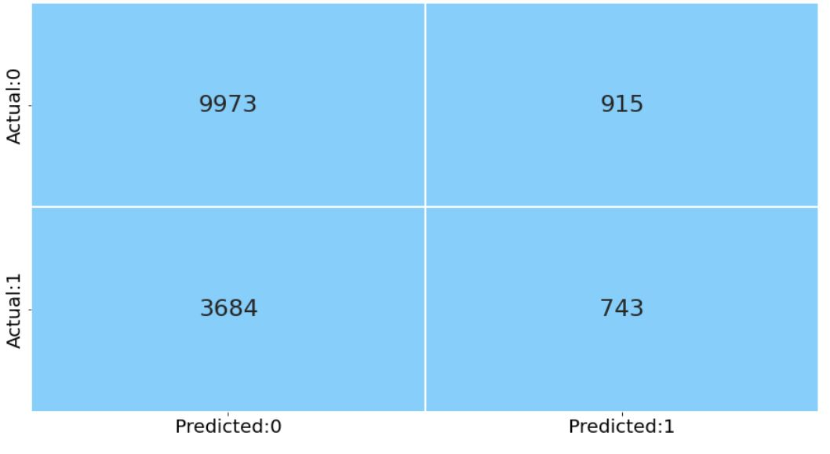
Inference:-
The train and test accuracies are comparable , hence the overfitting is reduced.
We observe that the FN values are reduced by 15% compared to the decision tree.
We further reduce the False Negatives values by using different boosting methods.

Slide 26
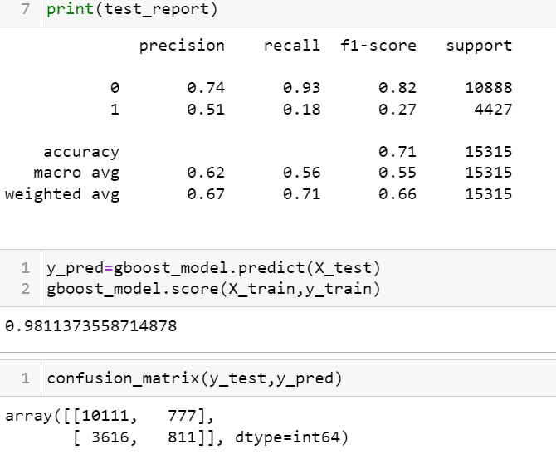
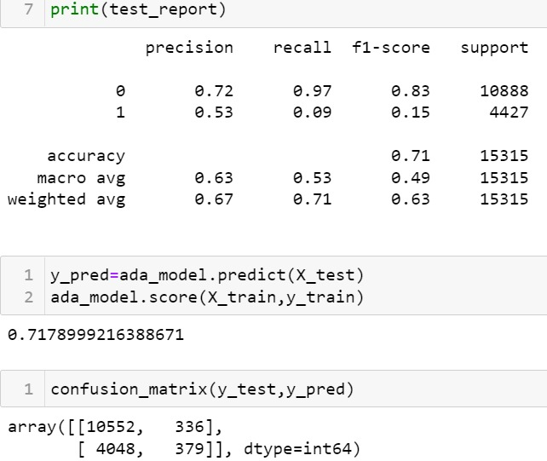
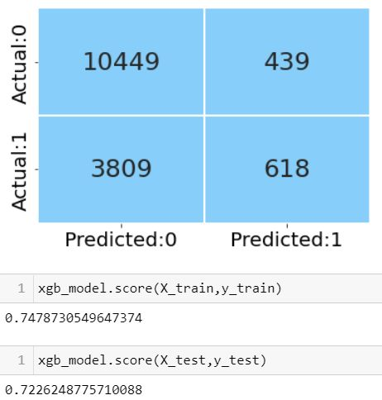
Gradient boosting scores:
Ada boost scores:
XG boost scores:
Boosting Scores:
Comparable accuracy scores and lesser False Negative values are obtained using XGBoost.
But the FN values are similar to once obtained in hyper tuned random forest model.

Slide 27
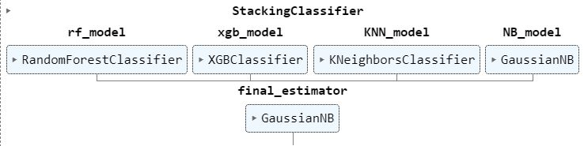
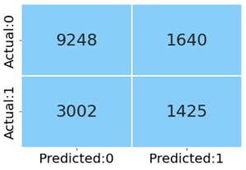
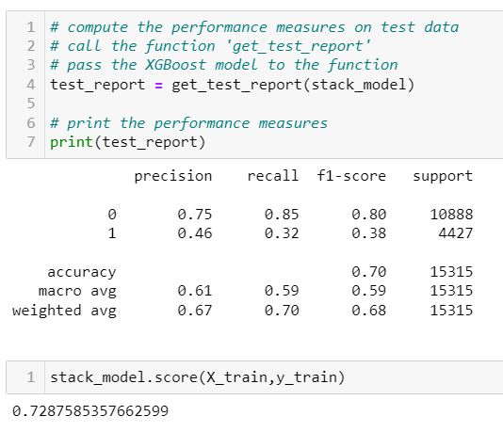
Stack Generalization:

Slide 28
Inference:-
According to stack Generalization report, we can observe that train test values are good.
Compare to base logistic model, the overfitting is reduced and FN errors are reduced by nearly 32%.
Comparatively the recall value has been boosted from 4% to 32% .
Compare to base Decision model, the overfitting is reduced and FN errors are reduced by nearly 30%.

Slide 29
Limitations:
The data which we have is highly imbalanced this might lead to inaccurate predictions.
To enhance the data quality and to reduce errors we have transformed the data using power transformer, getting Business insights out of this would be difficult.
To proceed with Feature Engineering, we need to have domain knowledge

Slide 30
Reference:
1.Customer Churn Analysis
Brief Overview of Customer Churn Analysis and Prediction with Decision Tree Classifier.
Retrieved from https://towardsdatascience.com/customer-churn-analysis-4f77cc70b3bd
2. Customer churn analysis: Churn determinants and mediation effects of partial defection in the Korean mobile telecommunications service industry (2006).
Retrieved from http://people.stern.nyu.edu/shan2/customerchurn.pdf
3. Kiran Dahiya, Surbhi Bhatia. Customer Churn Analysis in Telecom Industry.
Retrieved from https://ieeexplore.ieee.org/stamp/stamp.jsp?arnumber=7359318
4.Understanding Random Forest How the Algorithm Works and Why it Is So Effective. Retrieved from https://towardsdatascience.com/understanding-random-forest-58381e0602d2

Slide 31
Thank You

